Slide 1








Primary Prevention in Cardiovascular Disease
Para clinical Evaluations:
Biochemistry : Lipid and BS
Circulating biomarkers
Coronary Calcium Score
Carotid Intima-media Thickness
Arterial stiffness

Slide 2
Primary Prevention in Cardiovascular Disease
Circulating and urinary biomarkers:
Biomarkers can be classified into:
Inflammatory (e.g. hsCRP, fibrinogen)
Thrombotic (e.g. homocysteine, lipoprotein-associated phospholipase A2)
Glucose- and lipid-related markers (e.g. apolipoproteins)
Organ specific markers (e.g. renal, cardiac).

Slide 3


Primary Prevention in Cardiovascular Disease
hsCRP is most evaluated one.
While European internists and cardiologists enthusiastically measure cholesterol and blood pressure in virtually all of their patients, surprisingly few measure high sensitivity C-reactive protein (hsCRP), a validated measure of cardiovascular inflammation.
In the primary prevention setting, as shown in multiple cohorts and meta-analyses, measurement of hsCRP adds as much to risk prediction as does evaluation of HDL or total cholesterol, both of which are universally recommended in current European prevention guidelines (even in the absence of evidence that raising HDL cholesterol improves outcomes)

Slide 4

Primary Prevention in Cardiovascular Disease
Indeed, the risk associated with a 1 SD increase in hsCRP is at least as great, if not greater, than that associated with a comparable 1 SD increase in cholesterol or blood pressure, even after adjustment for a wide range of additional factors.
JUPITER trial—published more than a decade ago—made it clear that individuals with levels of hsCRP >2 mg/L benefit from statin therapy even in the absence of overt hyperlipidaemia.
Multiple trials have shown that the benefits of statin therapy relate to both lipid lowering and inhibition of inflammation.

Slide 5
Primary Prevention in Cardiovascular Disease
CANTOS provided proof of principle that targeting innate immunity, at least with a monoclonal antibody that reduces the critical interleukin-1ß to interleukin-6 to CRP pathway, significantly lowers recurrent rates of myocardial infarction and cardiovascular death among patients already treated with high intensity statins.
The magnitude of risk reduction observed with canakinumab (large reductions in interleukin-6 and CRP but no reduction in LDL cholesterol) was of similar magnitude to the risk reduction observed with PCSK9 (proprotein convertase subtilisin/kexintype 9) inhibition.

Slide 6
Primary Prevention in Cardiovascular Disease
The primary efficacy end point was nonfatal myocardial infarction, nonfatal stroke, or cardiovascular death
secondary end point that additionally included hospitalization for unstable angina that led to urgent revascularization

Slide 7
Primary Prevention in Cardiovascular Disease
The benefits of canakinumab were directly related to the magnitude of hsCRP and IL-6 lowering.
The importance of both lipid lowering and inhibition of inflammation is striking; as recently demonstrated in the FOURIER and SPIRE trials, residual inflammatory risk as evaluated by hsCRP remains unabated even among those with LDL cholesterol levels as low as 20mg/dL.

Slide 8
Primary Prevention in Cardiovascular Disease

Slide 9
Primary Prevention in Cardiovascular Disease

Slide 10

Primary Prevention in Cardiovascular Disease
9748 ARIC (Atherosclerosis Risk in Communities) study participants who were free of ASCVD at baseline (1996–1998) and had measurements of lipids, apolipoprotein B, and hsCRP.
There were 1574 ASCVD events over median (interquartile range) follow-up of 18.4 (12.8–19.5) years, and discordance between hsCRP and lipid measures was prevalent in 50% of the population.
hsCRP greater than or equal to median (2.4 mg/L), compared with less than median, was associated with an increased risk of ASCVD in individuals with less than median levels of lipid measures.

Slide 11
Primary Prevention in Cardiovascular Disease
Individuals with favorable atherogenic lipid levels , but a
discordantly elevated hsCRP level, had a 30% to 60% greater relative
risk of developing atherosclerotic CV events over median follow-up of
18 years.

Slide 12
Primary Prevention in Cardiovascular Disease

Slide 13
Primary Prevention in Cardiovascular Disease
Such increased risk was consistent among individuals with low (<7.5%) or high (≥7.5%) estimated risk.
elevated hsCRP consistently enhanced atherosclerotic cardiovascular disease risk in individuals regardless of their baseline absolute risk determined by various atherogenic lipid measures and the pooled cohort equation score.

Slide 14
What Are the Clinical Implications?
Primary Prevention in Cardiovascular Disease
• hsCRP levels should be regularly considered along with atherogenic lipid
measures in approach to ASCVD risk assessment.
• Elevated hsCRP levels can serve as a risk enhancer irrespective of baseline
absolute risk determined by various lipid measures and the pooled risk scores.
• Individuals with elevated hsCRP may additionally benefit from an intensive anti-
inflammatory lifestyle and also possibly from anti-inflammatory medications
such as high intensity statin therapy or colchicine; however, this requires
further prospective validation in clinical trials.

Slide 15
Primary Prevention in Cardiovascular Disease
Coronary Calcium Score

Slide 16
Primary Prevention in Cardiovascular Disease
CAC scanning is a non–contrast-enhanced image acquisition technique
that is performed during a single breath-hold.
Current guidelines recommend prospective ECG-triggered scanning from the bifurcation of the main pulmonary artery to the apex of the heart, with a 2.5- to 3-mm slice thickness.
No beta blockade is required, and the scan time is 3 to 5 seconds.
Both MDCT and EBCT scanners allow for adequate CAC scoring, although MDCT CAC imaging is the predominant method for contemporary CAC testing

Slide 17



Slide 18
Primary Prevention in Cardiovascular Disease
It is generally agreed that a CAC score of:
0 indicates the absence of calcified plaque
1 to 10 minimal
11 to 100 mildly elevated
101 to 400 moderately elevated
and greater than 400 indicate severely elevated CAC level
In some studies a CAC score of 300 or greater has been used as an alternative threshold to describe severely elevated CAC level. (ESC)

Slide 19
Primary Prevention in Cardiovascular Disease
likelihood of ischemic MPI is:
About 2% with CAC less than 100
more than one third of patients with CAC greater than 400

Slide 20


Coronary Calcium Score
Calcifications indicate late-stage subclinical coronary atherosclerosis.
Atherosclerotic coronary arteries do not necessarily always show calcifications.
The extent of the calcification correlates with the extent of total coronary plaque burden.
CAC score ≥75th percentile for age, sex and ethnicity is considered to indicate increased CV risk.

Slide 21


Coronary Calcium Score
For CAC scoring, the radiation exposure with properly selected techniques is +/-1 mSv.
CAC has shown a very high negative predictive value, since an Agatston score of 0 has a very high NPV ( near 100% ) for ruling out significant coronary narrowing.
The absence of coronary artery calcium does not rule out noncalcified plaque.
Including CAC may improve CV risk prediction in addition to conventional risk factors.

Slide 22
Coronary Calcium Score: who?

Slide 23
Primary Prevention in Cardiovascular Disease

Slide 24
Primary Prevention in Cardiovascular Disease

Slide 25
Primary Prevention in Cardiovascular Disease
Coronary artery calcium may even refine ASCVD risk estimates among:
lower-risk women (<7.5% 10-year risk)
younger adults (<45 years of age)
and older adults (≥75 years of age)
Might also be considered in refining risk for selected low-risk adults (<5% 10-year risk), such as those with a strong family history of premature coronary heart disease (CHD).
but more data are needed to support its use in these subgroups.

Slide 26

Primary Prevention in Cardiovascular Disease
In these groups, CAC measurement can reclassify risk :
upward (if CAC score is ≥100 Agatston units (AU) or ≥75th age/sex/race)
or downward (if CAC score is zero) .
This can help guide shared decision making about statins or potentially even aspirin.

Slide 27
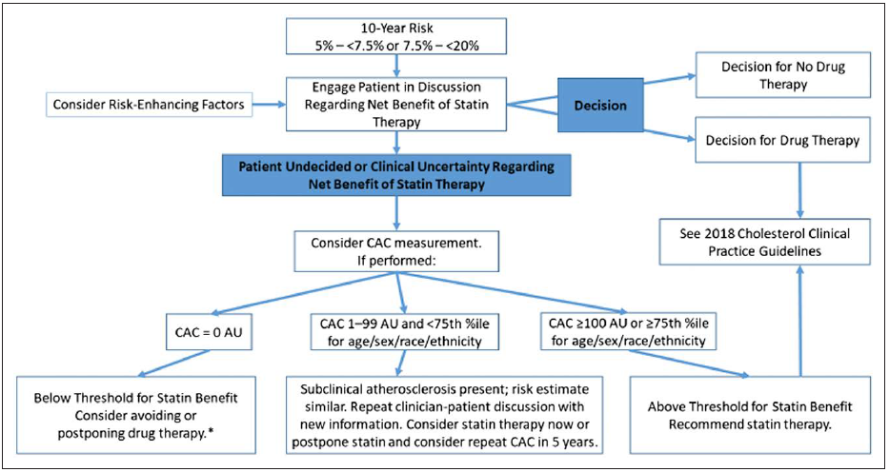
Primary Prevention in Cardiovascular Disease

Slide 28
Coronary Calcium Score
In the MESA (Multi- Ethnic Study of Atherosclerosis) trial, the coronary artery calcium score was strongly associated with 10-year ASCVD risk in a graded manner across age, sex, and racial/ethnic groups, independent of traditional risk factors.
A coronary artery calcium score of zero identifies individuals at lower risk of ASCVD events and death over a ≥10-year period.

Slide 29


Primary Prevention in Cardiovascular Disease
MESA and Astro-CHARM (Astronaut Cardiovascular Health and Risk Modification) are risk estimation tools that incorporate both risk factors and coronary artery calcium for estimating 10-year CHD and ASCVD risk, respectively.
Coronary artery calcium measurement is not intended as a “screening” test for all but rather may be used as a decision aid in select adults to facilitate the clinician–patient risk discussion.

Slide 30
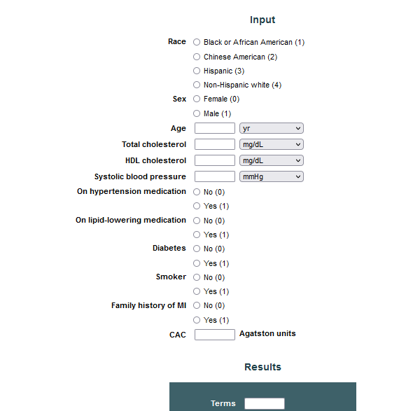


MESA 10-Year CHD Risk with Coronary Artery Calcification
https://ebmcalc.com/MESA.htm

Slide 31

Primary Prevention in Cardiovascular Disease
MESA: Risk of incident adverse events for individuals with a CAC score of 0 was very low, with a major adverse cardiovascular event (MACE) rate of 0.5% over 4 years.
Notably, In the MESA study, among participants followed for almost 10 years, CAC was an independent predictor of cerebrovascular risk, even after accounting for traditional cerebrovascular disease events
In a MESA analysis of 3398 patients followed for almost 8 years, the log- normalized CAC volume score was highly predictive for incident CAD events. However, higher CAC density demonstrated a protective influence, with CAC density scores associated with lower CAD risk.
SO, Agatston CAC score and for which higher density results in higher CAC scores, may require reexamination in prognostic studies.

Slide 32



Slide 33
CAC in Symptomatic Patients
Although the negative predictive value of a CAC score of 0 has been consistently demonstrated with an event rate in asymptomatic patients, with an annualized event rate of 0.5% over 5 years in recent meta-analyses, it should not be considered similarly in symptomatic patients.
Recent data from the multinational CONFIRM registry showed that 4% of symptomatic patients with CAC of 0 had obstructive CAD of 50% stenosis or more, and CAC offered no incremental discriminatory utility above CCTA.
Similarly, in the ROMICAT study, a CAC of 0 in acute chest pain patients did not adequately exclude acute coronary syndrome.

Slide 34
Carotid Intima-media Thickness
Primary Prevention in Cardiovascular Disease
There is an increase in CV risk with increasing IMT and a value > 0.9 mm is considered abnormal.
The risk of vascular events associated with IMT is non-linear, with hazards increasing more rapidly at lower IMTs than at higher IMTs.
The extent of carotid IMT is an independent predictor of CVD, but seems to be more predictive in women than in men.
The lack of standardization regarding the definition and measurement of IMT, its high variability and low intra-individual reproducibility have raised concerns

Slide 35
Primary Prevention in Cardiovascular Disease
With regard to CIMT, a meta-analysis of 14 population-based cohorts reported a consistent and statistically significant 9% increase in future vascular risk for each 0.1-mm increase in CIMT thickness.
however, that same analysis found CIMT unlikely of clinical importance once risk estimates and reclassification underwent adjustment for usual risk factors.
The Framingham investigators also have recently reported limited usefulness for CIMT in risk prediction, and current ACC/AHA guidelines do not endorse this approach to risk detection.

Slide 36
Arterial stiffness

Slide 37
Arterial stiffness
PWV threshold of 12 m/s has been suggested as a conservative estimate of significant alterations of aortic function in middle-aged hypertensive patients.
A meta-analysis showed that arterial stiffness predicts future CVD and improves risk classification.
However, the validity of this conclusion is offset by evidence of substantial publication
bias.
The Task Force concludes that arterial stiffness may serve as a useful biomarker to improve CV risk prediction for patients close to decisional thresholds, but its systematic use in the general population to improve risk assessment is not recommended

